Slide 1
Problem Solving by Search

Slide 2
An important aspect of intelligence is goal-based problem solving.
The solution of many problems can be described by finding a sequence of actions that lead to a desirable goal. Each action changes the state and the aim is to find the sequence of actions and states that lead from the initial (start) state to a final (goal) state.

Slide 3
A well-defined problem can be described by:
Initial state
Operator or successor function - for any state x returns s(x), the set of states reachable from x with one action
State space - all states reachable from initial by any sequence of actions
Path - sequence through state space
Path cost - function that assigns a cost to a path. Cost of a path is the sum of costs of individual actions along the path
Goal test - test to determine if at goal state

Slide 4
What is Search?
Search is the systematic examination of states to find path from the start/root state to the goal state.
The set of possible states, together with operators defining their connectivity constitute the search space.
The output of a search algorithm is a solution, that is, a path from the initial state to a state that satisfies the goal test

Slide 5
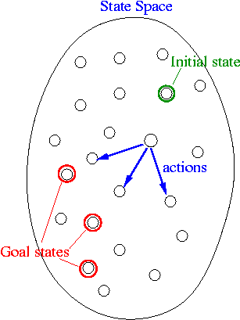
Search Problem
We are now ready to formally describe a search problem.
A search problem consists of the following:
• S: the full set of states
• s⁰ : the initial state
• A:S→S is a set of operators
• G is the set of final states.
Note that G ⊆S

Slide 6
The search problem is to find a sequence of actions which transforms the agent from the initial state to a goal state g∈G. A search problem is represented by a 4-tuple {S, s⁰, A, G}.
S: set of states
s⁰ ∈ S : initial state
A: S->S operators/ actions that transform one state to another state
G : goal, a set of states. G ⊆ S
This sequence of actions is called a solution plan. It is a path from the initial state to a goal state. A plan P is a sequence of actions.
P = {a⁰, a¹, … , a^{N}} which leads to traversing a number of states {s⁰, s¹, … , s^{N+1}∈G}. A sequence of states is called a path. The cost of a path is a positive number. In many cases the path cost is computed by taking the sum of the costs of each action.

Slide 7
Search
Search is the systematic examination of states to find path from the start/root state to the goal state.
The set of possible states, together with operators defining their connectivity constitute the search space.
The output of a search algorithm is a solution, that is, a path from the initial state to a state that satisfies the goal test.

Slide 8
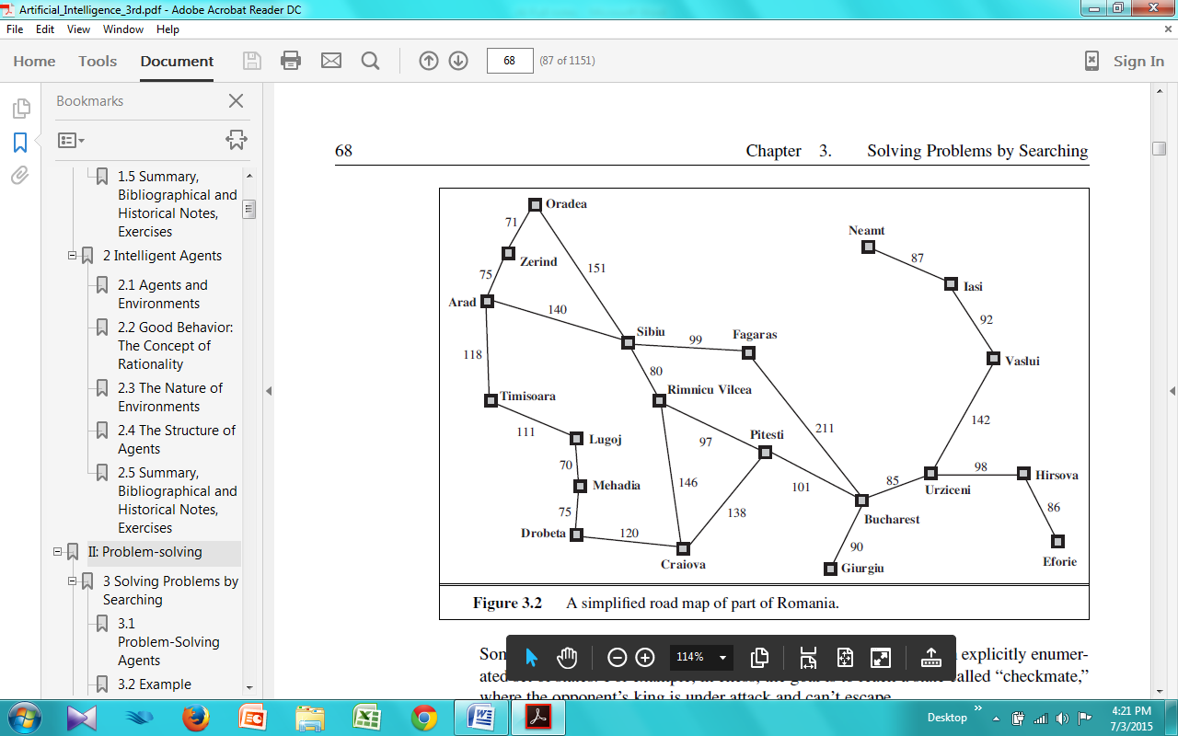
Problem-solving agents
Goal formulation,based on the current situation and the agent’s performance measure, is the first step in problem solving. The agent’s task is to find out which sequence of actions will get to a goal state.
Problem formulation is the process of deciding what actions and states to consider.
Notes:
T:A Problem solving agent is a goal-based agent . It decide what to do by finding sequence of actions that lead to desirable states. The agent can adopt a goal and aim at satisfying it.

Slide 9
Search
The process of looking for sequences actions from the current state to reach the goal state is called search.
The search algorithm takes a problem as input and returns a solution in the form of action sequence. Once a solution is found,the execution phase consists of carrying out the recommended action..
“formulate, search, execute”
Notes:
An agent with several immediate options of unknown value can decide what to do by examining different possible sequences of actions that leads to the states of known value, and then choosing the best sequence.

Slide 10
function SIMPLE-PROBLEM-SOLVING-AGENT( percept) returns an action
inputs : percept, a percept
static: seq, an action sequence, initially empty
state, some description of the current world state
goal, a goal, initially null
problem, a problem formulation
state UPDATE-STATE(state, percept)
if seq is empty then do
goal FORMULATE-GOAL(state)
problem FORMULATE-PROBLEM(state, goal)
seq SEARCH( problem)
action FIRST(seq);
seq REST(seq)
return action
←
←
←
←
←
←

Slide 11
initial state -In(Arad)
ACTIONS(s)-ACTIONS(Arad)
{Go(Sibiu), Go(Timisoara), Go(Zerind)}
RESULT(s, a) that returns the state that results from doing action a in state s.
RESULT(In(Arad),Go(Zerind)) = In(Zerind)

Slide 12
The goal test, which determines whether a given state is a goal state
possible goal states-the test simply checks whether the given state is one of them.
Goal- specified by an abstract property – checkmate
The step cost of taking action a in state s to reach state s¹ is denoted by c(s, a, s¹).
A solution to a problem is an action sequence that leads from the initial state to a goal state.
Solution quality is measured by the path cost function.
optimal solution has the lowest path cost among all solutions.

Slide 13
Example problems
Vacuum World Example
States: The agent is in one of two locations.,each of which might or might not contain dirt. Thus there are 2 x 2² = 8 possible world states.
Initial state: Any state can be designated as initial state.
Successor function : This generates the legal states that results from trying the three actions (left, right, suck). The complete state space is shown in figure 2.3
Goal Test : This tests whether all the squares are clean.
Path test : Each step costs one ,so that the the path cost is the number of steps in the path.

Slide 14
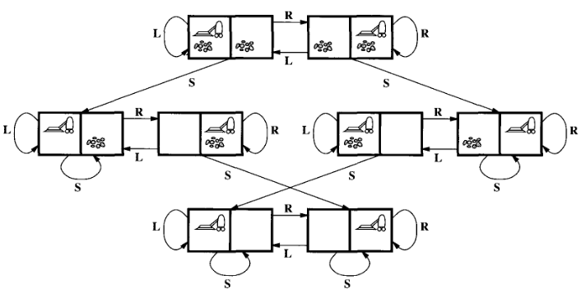

Slide 15
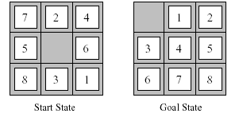
The 8-puzzle
An 8-puzzle consists of a 3x3 board with eight numbered tiles and a blank space. A tile adjacent to the blank space can slide into the space.
The problem formulation is as follows :
States : A state description specifies the location of each of the eight tiles and the blank in one of the nine squares.
Initial state : Any state can be designated as the initial state Successor function (blank moves Left, Right, Up or Down).
Goal Test : This checks whether the state matches the goal configuration Path cost : Each step costs 1,so the path cost is the number of steps in the path.

Slide 16
The 8-puzzle has 9!/2 = 181,440 reachable states and is easily solved.
The 15 puzzle ( 4 x 4 board ) has around 1.3 trillion states,an the random instances can be solved optimally in few milli seconds by the best search algorithms.
The 24-puzzle (on a 5 x 5 board) has around 10²⁵ states ,and random instances are still quite difficult to solve optimally with current machines and algorithms.

Slide 17
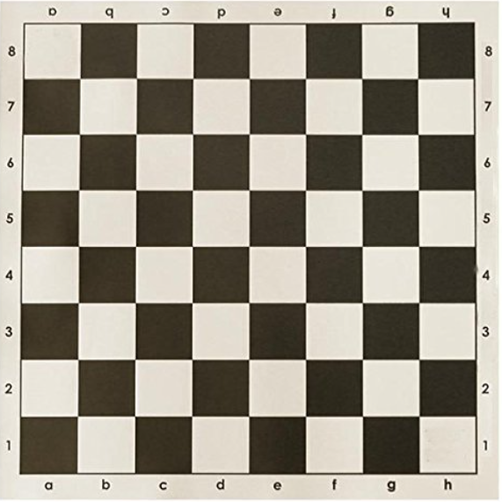

Slide 18
An Incremental formulation involves operators that augments the state description, starting with an empty state. for 8-queens problem, this means each action adds a queen to the state.
A complete-state formulation starts with all 8 queens on the board and move them around.
In either case the path cost is of no interest because only the final state counts.

Slide 19
The first incremental formulation one might try is the following :
States : Any arrangement of 0 to 8 queens on board is a state.
Initial state : No queen on the board.
Successor function : Add a queen to any empty square.
Goal Test : 8 queens are on the board,none attacked.
In this formulation,we have 64.63…57 = 3 x 10¹⁴ possible sequences to investigate.

Slide 20
A better formulation would prohibit placing a queen in any square that is already attacked. :
States : Arrangements of n queens ( 0 <= n < = 8 ) ,one per column in the left most columns ,with no queen attacking another are states.
Successor function : Add a queen to any square in the left most empty column such that it is not attacked by any other queen.
This formulation reduces the 8-queen state space from 3 x 10¹⁴ to just 2057,and solutions are easy to find.
For the 100 queens the initial formulation has roughly 10⁴⁰⁰ states whereas the improved formulation has about 10⁵² states. This is a huge reduction,but the improved state space is still too big for the algorithms to handle.

Slide 21
Infinite State space

Slide 22
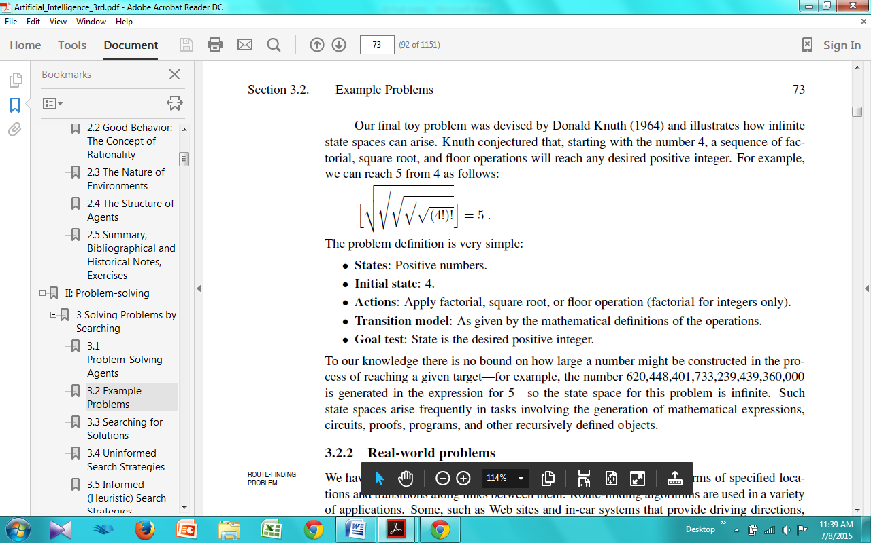
Infinite State space
The problem definition is very simple:
• States: Positive numbers.
• Initial state: 4.
• Actions: Apply factorial, square root, or floor operation (factorial for integers only).
• Transition model: As given by the mathematical definitions of the operations.
• Goal test: State is the desired positive integer.

Slide 24
REAL-WORLD PROBLEMS
Route-finding problem is defined in terms of specified locations and transitions along links between them.
Applications:
routing in computer networks,
military operations planning,
and air line travel planning systems.

Slide 25
The airline travel problem is specifies as follows :
States : Each is represented by a location(e.g.,an airport) and the current time.
Initial state : This is specified by the problem.
Successor function : This returns the states resulting from taking any scheduled,leaving later than the current time plus the within-airport transit time,from the current airport to another.
Goal Test : Are we at the destination by some prespecified time?
Path cost : This depends upon the monetary cost,waiting time,flight time,customs and immigration procedures,seat quality,time of dat,type of air plane,frequent-flyer mileage awards, and so on.

Slide 26
THE TRAVELLING SALESPERSON PROBLEM(TSP)
Is a touring problem in which each city must be visited exactly once. The aim is to find the shortest tour.The problem is known to be NP-hard. Enormous efforts have been expended to improve the capabilities of TSP algorithms.

Slide 27
VLSI layout
A VLSI layout problem requires positioning millions of components and connections on a chip to minimize area ,minimize circuit delays,minimize stray capacitances,and maximize manufacturing yield. The layout problem is split into two parts : cell layout and channel routing.

Slide 28
ROBOT navigation is a generalization of the route-finding problem. Rather than a discrete set of routes,a robot can move in a continuous space with an infinite set of possible actions and states. For a circular Robot moving on a flat surface,the space is essentially two-dimensional.
When the robot has arms and legs or wheels that also must be controlled,the search space becomes multi-dimensional. Advanced techniques are required to make the search space finite.

Slide 29
AUTOMATIC ASSEMBLY SEQUENCING
The example includes assembly of intricate objects such as electric motors. The aim in assembly problems is to find the order in which to assemble the parts of some objects. If the wrong order is choosen,there will be no way to add some part later without undoing somework already done.
Another important assembly problem is protein design,in which the goal is to find a sequence of Amino acids that will be fold into a three-dimensional protein with the right properties to cure some disease.

Slide 30
INTERNET SEARCHING
In recent years there has been increased demand for software robots that perform Internet searching.,looking for answers to questions,for related information,or for shopping deals. The searching techniques consider internet as a graph of nodes(pages) connected by links.

